Slide 1
ANATOMY OF THE PHARNYX
BY
DR OJEWALE A.O

Slide 2
Outline
Intro
Parts
Pharyngeal wall
Pharyngeal spaces
Pharyngeal muscles
Relations
Arterial supply
Venous drainage
Nerve supply
Lymphatic drainage
Applied Anatomy

Slide 3
Intro
The pharynx is a fibromuscular tube located behind the nasal cavities, mouth and larynx.
Extends from the base of the skull above to the level of the lower border of the cricoid cartilage (C6) below.
Measures 12-14 cm in length.
Is widest above, where it measures 3.5 cm but narrows below (at its junction with the oesophagus) where it is 1.5 cm wide.

Slide 4
Cont’d
The alimentary tract is narrowest at the pharyngo-oesophagus junction (except for the vermiform appendix). This junction is about 15 cm from the incisor teeth.
It is divided into three parts: these include the nasopharynx (lying behind the nose), oropharynx (lying behind the oral cavity), and laryngopharynx (lying behind the larynx).
It is invested externally by the bucopharyngeal fascia.

Slide 5
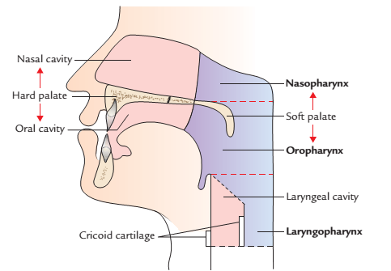
Subdivisions of the pharynx

Slide 6
Nasopharynx (Nasal Part of the pharynx)
It is the part of the pharynx located above the soft palate, and behind the nasal cavities.
It is respiratory in function and is thus lined by the respiratory (pseudostratified ciliated columnar) epithelium.
It has a roof formed by the body of sphenoid and the basilar part of occipital bone, a floor formed by the soft palate (sloping upper surface).
It communicates anteriorly with the nasal cavities via the posterior nasal apertures (choanae).
It has a posterior wall formed by the continuous sloping surface with roof and It is supported by anterior arch of C1 vertebra.
It is bounded laterally by the medial pterygoid plate of sphenoid.

Slide 7
Cont’d
It is linked to the tympanic cavities by the pharyngotympanic (auditory) tubes. These open onto the lateral walls of the pharynx (one on each side).
It is continuous below with the oropharynx through the pharyngeal isthmus. The pharyngeal isthmus is closed during the swallowing by the soft palate.
Its walls are rigid and non-collapsible to keep the air passage patent.

Slide 8
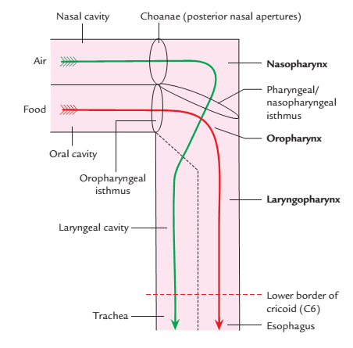
Pathways for food (red arrow) and air (green
arrow) through the pharynx

Slide 9
The features of nasopharynx
On each of its lateral walls is the pharyngeal opening of the auditory tube; this opening is located about 10 mm behind (and slightly below) the posterior end of the inferior nasal concha.
The pharyngeal opening of each auditory tube is bounded above and behind by a mucosal elevation- tubal elevation. This is produced by the medial end of the cartilaginous part of the auditory tube.

Slide 10
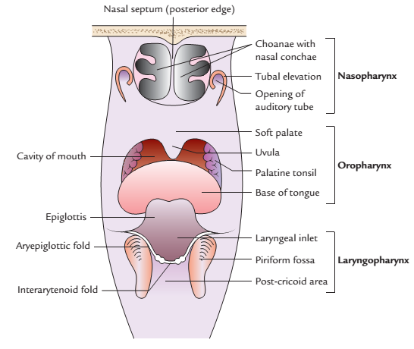
The pharynx opened from behind showing features in the anterior walls of the nasopharynx, oropharynx, and laryngopharynx.

Slide 11
Cont’d
Descending from the tubal elevation is a vertical fold of mucosa , the salpingopharyngeal fold; this contains salpingopharyngeus.
Behind the tubal elevation, the pharyngeal wall has a lateral depression termed pharyngeal recess (fossa of Rosenmuller).
In the roof and posterior wall of the nasopharynx is the nasopharyngeal (pharyngeal) tonsil (adenoids). This is an aggregation of lymphoid tissue (and is much more prominent in children).

Slide 12
Oropharynx (Oral Part of the Pharynx)
It lies behind the oral cavity and extends from the lower surface of the soft palate above to the upper border of epiglottis below.
It communicates anteriorly with the oropharyngeal isthmus (through which it opens into the oral cavity) and the pharyngeal part of the tongue.
It has a roof formed by the soft palate (under surface) and the pharyngeal isthmus through which it communicated with the nasopharynx.
It has a floor formed by the posterior 1/3rd of the tongue and the Interval between the tongue and epiglottis.
It is bounded laterally on each side, it is supported by pterygomandibular raphe, mandible, tongue, and hyoid bone

Slide 13
Cont’d
It is related posteriorly to the body of C2 vertebra and upper part of the body of C3 vertebra.
It has a lining of stratified squamous non-keratinized epithelium.

Slide 14
The features of oropharynx
The lateral wall of oropharynx presents palatine tonsils, one on either side. It is located into a triangular fossa (tonsillar fossa) bounded anteriorly by palatoglossal arch and posteriorly by palatopharyngeal arch.
The palatoglossal arch runs downwards and forwards from palate to the lateral margin of the tongue. The palatopharyngeal arch runs downwards and backwards to the pharyngeal wall where it fades out.

Slide 15
Cont’d
Anterior wall of oropharynx presents:
Lingual tonsil, formed by numerous nodules of lymphoid tissue underneath the mucous lining of the pharyngeal part of the dorsum of the tongue.
Upper free end of epiglottis, behind the tongue.
Median and lateral glossoepiglottic folds, connecting the anterior surface and edges of the epiglottis, respectively to the tongue.
Epiglottic valleculae are shallow fossa between the median and lateral glossoepiglottic folds.
.

Slide 16
Oropharyngeal Isthmus
It is an arched opening between the two palatoglossal folds through which the oral cavity communicates with the oropharynx.
It is bounded above by the soft palate.
It is bounded below by the dorsal surface of the posterior one-third of the tongue.
It is bounded laterally by the palatoglossal fold/arch on either side containing palatoglossus muscle.
The oropharyngeal isthmus is closed during deglutition to prevent regurgitation of food from the pharynx to the mouth.

Slide 17
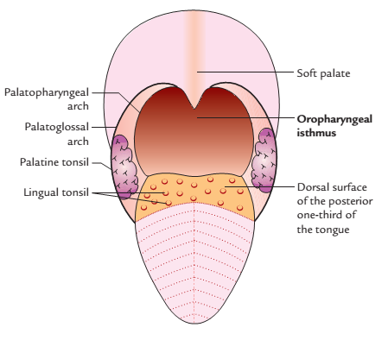
Boundaries of the oropharyngeal isthmus

Slide 18
Laryngopharynx
The laryngopharynx lies behind the laryngeal inlet and posterior wall of the larynx. It lies behind the larynx and extends from the upper border of the epiglottis to the lower border of cricoid cartilage anteriorly and lower border of C6 vertebra posteriorly. It communicates anteriorly with the laryngeal cavity through laryngeal inlet and inferiorly with the esophagus at the pharyngoesophageal junction (the narrowest part of the GIT except appendix).

Slide 19
Boundaries of laryngopharynx
Anterior wall: It is formed by:
Laryngeal inlet.
Posterior surface of the larynx.
Posterior wall: It is supported by the bodies of C3, C4, C5, and C6 vertebrae.
Lateral wall: It is supported by thyroid cartilage and thyrohyoid membrane.

Slide 20
Features
The features of the laryngopharynx are:
Anterior wall presents laryngeal inlet and below the laryngeal inlet, it is supported by cricoid and arytenoid cartilages.
Lateral wall presents piriform fossa one on each side of laryngeal inlet.

Slide 21
Piriform fossa
It is a deep recess broad above and narrow below in the anterior part of lateral wall of the laryngopharynx, on each side of the laryngeal inlet. These recesses are produced due to bulging of larynx into laryngopharynx.

Slide 22
Boundaries of the piriform fossa
Medial: Aryepiglottic fold and quadrangular membrane of larynx.
Lateral: Mucous membrane covering the medial surface of the lamina of thyroid cartilage and thyrohyoid membrane.
The internal laryngeal nerve and superior laryngeal vessels pierce the thyrohyoid membrane and traverse underneath the mucous membrane of the floor of the fossa to reach the medial wall.
Above: It is separated from epiglottic vallecula by lateral glossoepiglottic fold.

Slide 23
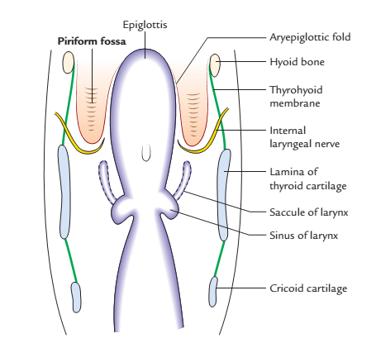
Coronal section through larynx showing the location and boundaries of the piriform fossa

Slide 24
Pharyngeal wall
The wall of the pharynx consists of four layers; from within outwards these are as follows:
Mucous membrane/mucous coat.
Pharyngobasilar fascia (pharyngeal aponeurosis).
Muscular coat (pharyngeal muscles).
Buccopharyngeal fascia (loose areolar sheath).

Slide 25
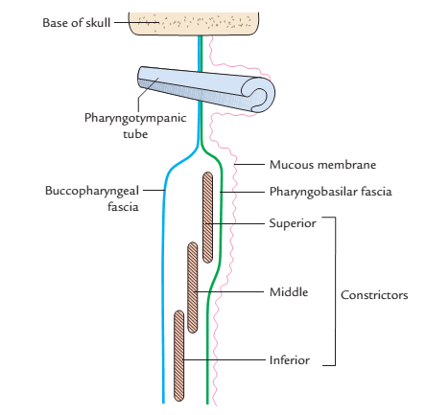
Structure of the pharyngeal wall

Slide 26
Cont’d
Mucous membrane/mucous coat: The mucous membrane lining the pharynx contains a considerable amount of elastic tissue and is continuous with the mucous lining of eustachian tubes, nasal cavities, mouth, larynx, and esophagus. It is lined by stratified squamous (non-keratinized) epithelium in the oropharynx and laryngopharynx), except in the region of the nasopharynx, where it is lined by pseudostratified ciliated columnar epithelium (respiratory epithelium). A zone lined by cuboidal epithelium however lies between the oropharynx and laryngopharynx

Slide 27
Cont’d
Pharyngobasilar fascia: It is a fibrous thickening of the submucosa. It lines the muscular coat and It is thick near the base of the skull but thin and indistinct inferiorly. It is thickest:
(a) in the upper part where it fills the gap between the upper border of superior constrictor and the base of the skull.
(b) posteriorly where it forms the pharyngeal raphe.
Muscular coat: The muscular coat consists of the following two layers of striated muscles:
The outer layer comprises three pairs of circular muscles called constrictors.
The inner layer comprises three pairs of longitudinal muscles

Slide 28
Cont’d
Buccopharyngeal fascia: It is an inconspicuous fascia, which covers the outer surface of constrictor muscles. In the upper part, it is also prolonged forwards to cover the buccinator muscles, hence the name buccopharyngeal fascia. Above the upper border of the superior constrictor, it blends with the pharyngobasilar fascia.

Slide 29
Pharyngeal spaces
These are potential spaces in relation to pharynx, viz.
Retropharyngeal space: It is situated behind the pharynx and extends from the base of the skull above to the bifurcation of trachea below.
Parapharyngeal space: It is situated on the side of the pharynx. It contains carotid vessels, internal jugular vein, last four cranial nerves, and cervical sympathetic chain.

Slide 30
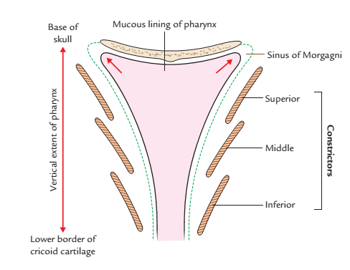
Pharyngeal muscles
Constrictor muscles: The three constrictor muscles of the pharynx (superior, middle, and inferior) are arranged like a flowerpot without base, placed one above the other and open in front for communication with the nasal, oral, and laryngeal cavities. Thus inferior constrictor overlaps the middle, which in turn overlaps the superior constrictor.
They form bulk of the muscular coat of the pharyngeal wall. They arise in front from the margins of posterior openings of the nasal, oral, and laryngeal cavities.
Overlapping arrangement of the constrictor muscles of the pharynx

Slide 31
Cont’d
The fibres pass backwards, in a fan-shaped manner into the lateral and posterior walls of the pharynx to be inserted into the median fibrous raphe on the posterior aspect of the pharynx, extending from the base of the skull (pharyngeal tubercle of occipital bone) to the esophagus.

Slide 32
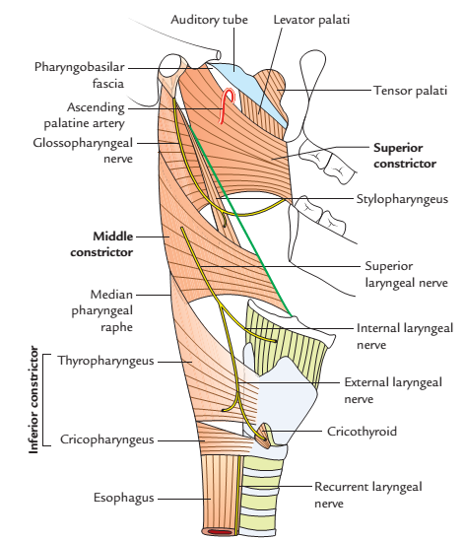
Origin and insertion of the constrictors of the pharynx

Slide 33
Origin, insertion, nerve supply, and actions of the constrictor muscles of the pharynx
Muscle | Origin | Insertion | Nerve supply | Action
Superior constrictor (Quadrilateral in shape) | (a) Pterygoid hamulus (b) Pterygomandibular raphe (c) Medial surface of the mandible at the upper end of mylohyoid line (d) Side of the posterior part of the tongue | (a) Pharyngeal tubercle on the base of skull (b) Median fibrous raphe | Pharyngeal branch of the vagus nerve carrying fibres of cranial root of the accessory nerve | Helps in deglutition
Middle constrictor (Fan shaped) | (a) Lower part of the stylohyoid ligament (b) Lesser cornu of hyoid (c) Upper border of greater cornu of hyoid | Median fibrous raphe | Pharyngeal branch of the vagus nerve carrying fibres of cranial root of the accessory nerve | Helps in deglutition

Slide 34
Cont’d
Muscle | Origin | Insertion | Nerve supply | Action
Inferior constrictor (a) Thyropharyngeus | (a) Oblique line on lamina of the thyroid cartilage (b) Tendinous band between the thyroid (inferior) tubercle and cricoid cartilage | Median fibrous raphe | (a)Pharyngeal plexus and (b) External laryngeal nerve | Helps in deglutition
(b) Cricopharyngeus | Cricoid cartilage | Median fibrous raphe | Recurrent laryngeal nerve

Slide 35
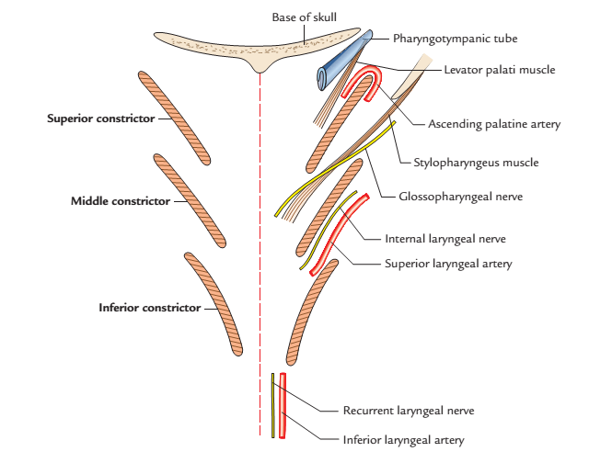
Gaps in the pharyngeal wall
The four gaps exist on either side in the pharyngeal wall in relation to constrictor muscles. The gaps and structures passing through these gaps.

Slide 36
The gaps in the pharyngeal wall and structures passing through them
Gap | Structures passing through them
Between the base of skull and the upper concave border of superior constrictor (sinus of Morgagni) | Auditory tube Levator palati muscle Ascending palatine artery Palatine branch of the ascending pharyngeal artery
Between the superior and middle constrictors | Stylopharyngeus muscle Glossopharyngeal nerve
Between the middle and inferior constrictors | Internal laryngeal nerve Superior laryngeal vessels
Between the lower border of inferior constrictor and the esophagus (in the tracheoesophageal groove) | Recurrent laryngeal nerve Inferior laryngeal vessels

Slide 37
Longitudinal muscles
They are a group of muscles that run longitudinally along the pharynx from above downwards to form the longitudinal muscle coat.
The three longitudinal muscles of the pharynx are, stylopharyngeus, palatopharyngeus, and salpingopharyngeus.

Slide 38
Origin, insertion, and nerve supply of the longitudinal muscles of the pharynx
Muscle | Origin | Insertion | Nerve supply
Stylopharyngeus | Medial surface of the base of styloid process of the temporal bone | Pharyngeal wall & posterior border of the lamina of thyroid cartilage | Glossopharyngeal (IX) nerve
Palatopharyngeus | Hard palate and upper surface of the palatine aponeurosis | Pharyngeal wall & posterior border of the lamina of thyroid cartilage | Cranial root of accessory (11th) nerve via pharyngeal plexus of vagus nerve
Salpingopharyngeus | Lower part of the cartilage of the auditory tube | Posterior border of the lamina of thyroid cartilage, It blends with the palatopharyngeus into the pharyngeal wall. | Cranial root of accessory (11th) nerve via pharyngeal plexus of vagus nerve

Slide 39
Cont’d
Actions of the longitudinal muscles
They elevate the larynx, shorten and widen the pharynx during swallowing (deglutition). At the same time, palatopharyngeal sphincter formed by some fibres of the palatophayngeus muscle closes the nasopharyngeal isthmus.

Slide 40
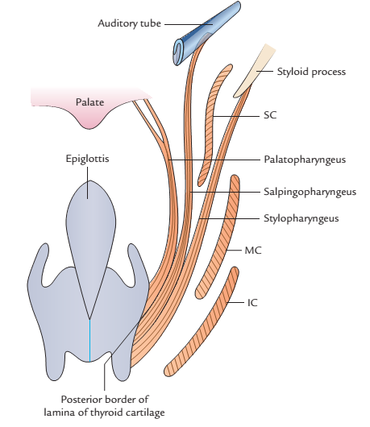
Origin and insertion of the longitudinal muscles of the pharynx

Slide 41
Relations of the pharnyx
Above to the base of skull including posterior part of sphenoidal body and basilar part of occipital bone in front of pharyngeal tubercle.
Below to the oesophagus (with which it is directly continuous)
Behind to the retropharyngeal space, prevertebral fascia, prevertebral muscles (longus colli and longus capitis) and cervical part of the vertebral column.
In front to the nasal and oral cavities, and the larynx.
Laterally (on each side) to the styloid process and its attached muscles, upper end of thyroid lobe, carotid sheath (and its contents), and the glossopharyngeal, vagus, accessory and hypoglossal nerves.

Slide 42
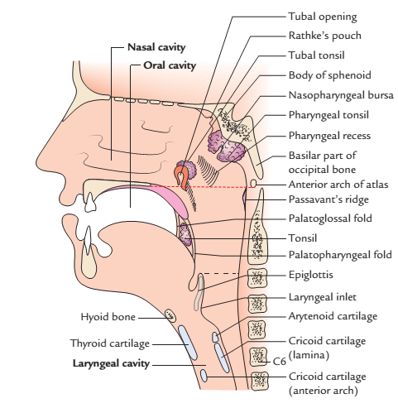
The sagittal section through the nose, mouth, pharynx, and larynx.

Slide 43
Arterial supply of the pharynx
The branches of the following arteries supply the pharynx:
Ascending pharyngeal artery (from external carotid artery).
Ascending palatine and tonsillar arteries (from facial artery).
Greater palatine and pharyngeal arteries (from maxillary artery).
Lingual artery (from external carotid artery).

Slide 44
Venous drainage of the pharynx
It is largely drained into pharyngeal venous plexus, which, like the pharyngeal nerve plexus, is situated on the posterolateral aspect of the pharynx over the middle constrictor. It drains into the internal jugular vein.

Slide 45
Nerve supply of the pharynx
Motor: All the pharyngeal muscles are supplied by the cranial root of accessory nerve (via pharyngeal branch of vagus and pharyngeal plexus), except the stylopharyngeus which is supplied by the glossopharyngeal nerve.
Sensory:
Nasopharynx, by pharyngeal branch of the pterygopalatine ganglion carrying fibres from maxillary division of the trigeminal nerve.
Oropharynx, by glossopharyngeal nerve.
Laryngopharynx, by the internal laryngeal nerve.

Slide 46
Pharyngeal plexus of the nerves
It lies on the posterolateral aspect of the pharynx over the middle constrictor underneath the buccopharyngeal fascia.
It is formed by:
Pharyngeal branch of the vagus nerve carrying fibres from cranial part of the accessory nerve.
Pharyngeal branch of the glossopharyngeal nerve.
Pharyngeal branch from superior cervical sympathetic ganglion.

Slide 47
Lymphatic drainage of the pharynx
The lymph from pharynx is drained into the upper and lower deep cervical lymph nodes directly and through retropharyngeal lymph nodes.

Slide 48
Applied anatomy
Since the pathways for food and air cross each other in the oropharynx, the food sometimes may enter into the respiratory tract and cause choking. Similarly, the air often enters the digestive tract producing gas in the stomach, which results in eructation (belching).
A malignant tumor of the laryngopharynx (hypopharynx) may grow in the space provided by the piriform fossa without producing symptoms until the patient presents with metastatic lymphadenopathy.

Slide 49
Cont’d
The ingested foreign bodies (e.g., fish bones, safety pins) are sometimes lodged into the piriform fossa. If care is not taken, the removal of foreign bodies may damage the internal laryngeal nerve leading to anesthesia in the supraglottic part of the larynx and subsequent loss of protective cough reflex.

Slide 50
Cont’d
Waldeyer’s ring: The aggregations of lymphoid tissue underneath the epithelial lining of pharyngeal wall called tonsils, surround the commencement of air and food passages. These aggregations together constitute an interrupted circle called Waldeyer’s ring, which forms the special feature of the interior of the pharynx.

Slide 51
Cont’d
The Waldeyer’s ring is formed by pharyngeal tonsil (nasopharyngeal tonsil), posterosuperiorly.
Lingual tonsil, anteriorly.
Tubal and palatine tonsils, laterally.
Waldeyer’s ring prevents the invasion of microorganisms from entering the air and food passages and this helps in the defense mechanism of the respiratory and alimentary systems.

Slide 52
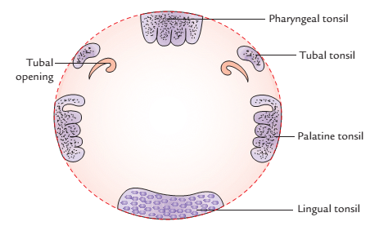
Cont’d

Slide 53
Cont’d
Pharyngeal Pouch (also called Zenker’s diverticulum):Inferior constrictor muscle has two parts: thyropharyngeus made up of oblique fibres and cricopharyngeus made up of transverse fibres.
The potential gap posteriorly between the thyropharyngeus and cricopharyngeus is called pharyngeal dimple or Killian’s dehiscence.
The mucosa and submucosa of the pharynx may bulge through this weak area to form a pharyngeal pouch or diverticulum.

Slide 54
Cont’d
The formation of pharyngeal pouch in the region of Killian’s dehiscence is attributed to the neuromuscular incoordination in this region, which may be because the two parts of the inferior constrictor have different nerve supply.
The propulsive thyropharyngeus is supplied by the pharyngeal plexus and the sphincteric cricopharyngeus is supplied by the recurrent laryngeal nerve. If the cricopharyngeus fails to relax when the thyropharyngeus contracts, the bolus of food is pushed backwards and tends to produce a diverticulum.

Slide 55
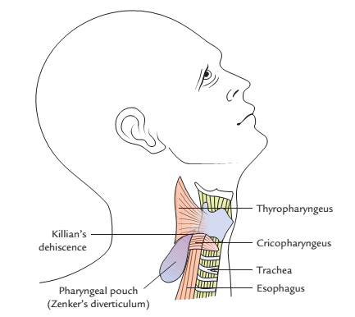
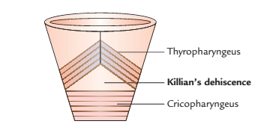
Killian’s dehiscence
Pharyngeal diverticulum

Slide 56
THANK YOU ALL, FOR LISTENING.

Slide 57


